Slide 1

Secure Azure Functions apps
Kuppurasu Nagaraj
Software Engineer – Kovai.co
Microsoft MVP, MCT
kuppurasu360

Slide 2
Agenda
Azure Functions overview
Why Azure Functions?
Creating your first Azure Functions App
Creating Azure Functions in Visual Studio
Securing Azure Functions apps
Authorization Levels
Whitelisting in Azure Functions
Securing an Azure Function App with Azure AD
Integrate Key Vault Secrets With Azure Functions

Slide 3
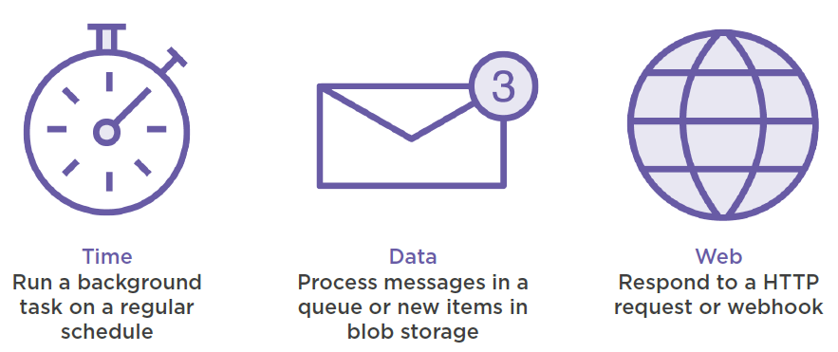
Azure Functions = Events + Code

Slide 4
Why Azure Functions?
Fully managed compute environment
Security
Auto-scaling
Pay-per-use (Consumption plan)
Less boilerplate code to write/maintain
Integrate easily with range of services

Slide 5
Type of Trigger
HTTPTrigger - execution of your code by using an HTTP request
TimerTrigger - Execute cleanup or other task on a predefined schedule
CosmosDBTrigger - added or updated in collections
BlobTrigger - You might use this function for image resizing
QueueTrigger - Respond to messages as they arrive

Slide 6
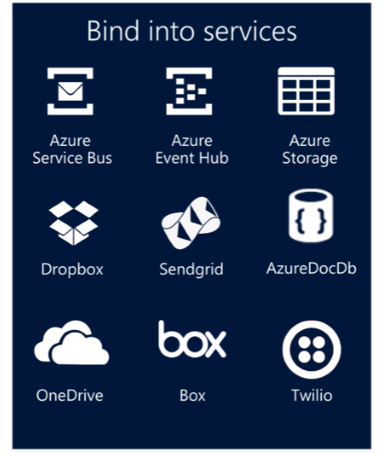
Integration
It integration with other Azure services such as Logic Apps, Event Hub, CosmoDB, Azure Blob Storage, Application Insight, etc.
Notes:
fsdfsdfdsf

Slide 7
Platform and scaling
App Service offers dedicated and dynamic tiers.
Dedicated(App Service Plan) is the existing App Service plan tiers
Basic, Standard, Premium
Pay based on # of reserved VMs
You’re responsible for scale
Dynamic (Consumption Plan)
Pay on number of executions
Platform responsible for scale

Slide 8
Supported Languages
C#
F#
JavaScript
JAVA
PowerShell
Python
TypeScript

Slide 9
Azure Function Demo

Slide 10
Resources
Create serverless logic with Azure Functions:
https://docs.microsoft.com/en-us/learn/modules/create-serverless-logic-with-azure-functions/
Execute an Azure Function with triggers:
https://docs.microsoft.com/en-us/learn/modules/execute-azure-function-with-triggers/
Develop, test, and deploy an Azure Function with Visual Studio:
https://docs.microsoft.com/en-us/learn/modules/develop-test-deploy-azure-functions-with-visual-studio/

Slide 11


Slide 12


